Slide 1


Funding for Energy Efficiency Projects
An Introduction
to Salix Finance
Calderdale
March 2018
Notes:
Talk for the next 10 mins about why you’d carry out projects, how to identify, how Salix can help and a couple of case studies.

Slide 2

Why carry out energy efficiency projects?
Notes:
Benefits;
Save money on energy bills
Improve learning environment
Local action on climate change
Education future generation – discuss in assembly, get children involved e.g. switch off campaigns, teach % in maths

Slide 3
How to identify projects
Notes:
Can look at energy spend per pupil by getting your yearly energy spend and dividing it by the number of pupils
£39 recommended for primary schools and £60 recommended for Secondary schools
Look at your DEC
If you have a care taker they may already be aware of measure that could be implemented
Speak to the council who may be able to come to the school and help you identify

Slide 4
How can Salix help?
Making a difference since 2004
100% interest-free capital finance for the public sector
Over 100 technologies funded
Notes:
Installing different technologies costs money which is where Salix comes in.
We receive all our funding from the government to provide the capital for energy efficiency projects
No maximum amount of funding you can apply for and we work throughout the UK and public sector so we’ve funded 5million pound projects in NHS buildings
No associated costs we are non-for-profit. The money we pay you is for the exact cost of the project. the money is then repaid to Salix through savings in energy bills

Slide 5

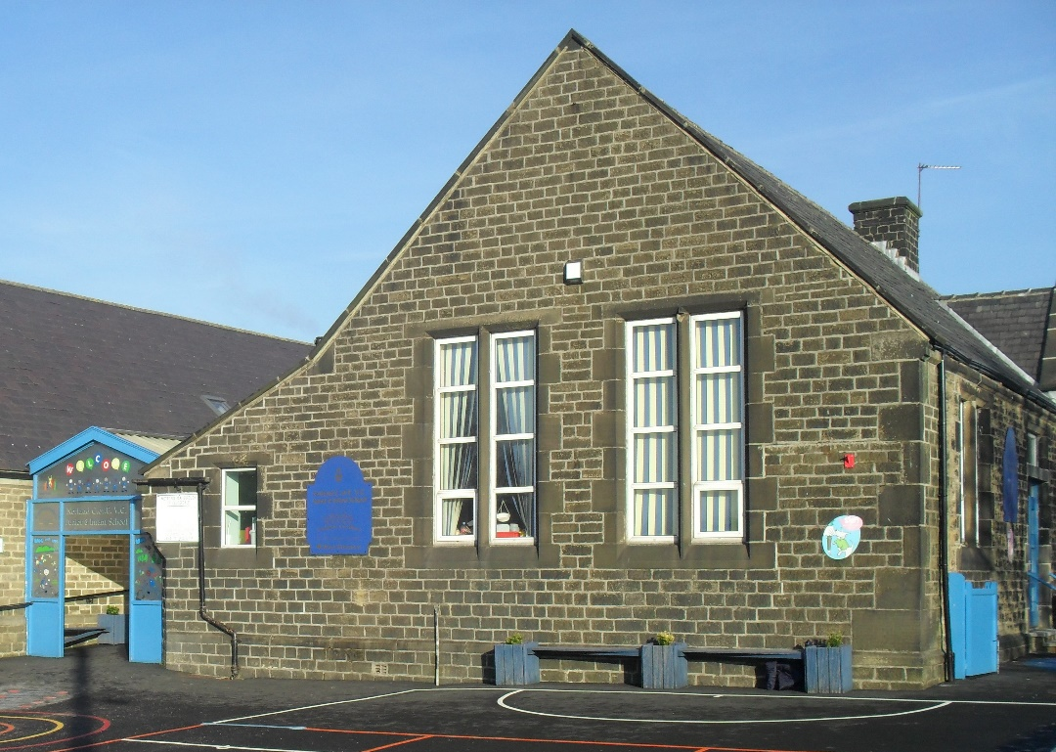
Norland CE School
Project overview
The project cost £13,627
£12,946 Salix loan
Solar PV project
Estimated Savings*
Annual savings
£1,618
Annual tCO₂ savings 4
Lifetime Savings
£36,412
Project payback
8 years
* Calculated using emissions factors published by government in 2017 for carbon footprinting purposes
Notes:
This project completed in November
95% of project costs.
Calderdale Council helped the school with the development of the project and signposted four installers for quotations.

Slide 6

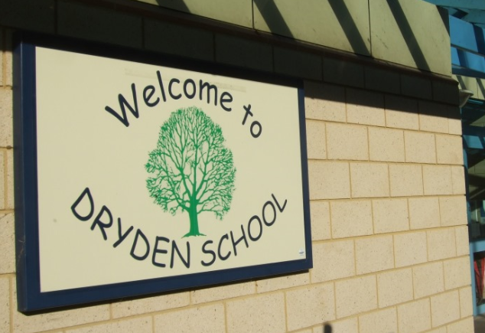
Dryden School case study
Project overview
£77,965 loan
Estimated 40% reduction in energy consumption
LED
Pipework insulation
Building Energy Management System
Draught proofing
Estimated Savings*
Annual savings
£17,813
Annual tCO₂ savings 88
Lifetime Savings
£241,838
Project payback
4.4 years
* Calculated using emissions factors published by government in 2013 for carbon footprinting purposes
Notes:
In Gateshead
Hollistic approach is recommended to reduce energy spend as much as possible. Bigger cost up front, but Salix cover this cost and long term Dryden is going to benefit from massive annual energy savings.
We take average payback if applied for in one application e.g. if boilers paid back in 12 year but LED in 4.
Long term it will save time and minimise disruption on site

Slide 7
Switching to Low Energy
Comprehensive energy survey
List of all possible energy efficiency improvements
Advice on behaviour change
Procurement tool
Funding options explored
Notes:
Look at 100 technologies including Solar & what order to make these improvements and the paybacks of these.
Procurement tool to allow you to procure the project

Slide 8
The Salix application process
1. Apply online www.salixfinance.co.uk/loans
3. Funds committed
4. Project starts
5. Loan paid on completion
2. Salix’s technical assessment
Notes:
If you know what projects you want to install then you can just apply directly for our funding.
Online application form with contact details – this can be done by the school, council or consultant
Salix Compliance Tool detailing your projected savings information, fill in projected savings etc and it throws out some numbers and tells you if it is compliant. If it isn't compliant our technical team can work with you to help make it fit within our criteria.
On application we do ask that you have LA and governors approval & are able to process direct debits.
technical team – typically takes up to 2 weeks. Then we commit the funds and you are free to start with the project.
9 months to complete & the loan is paid upon completion – can do interims if necessary, payments start after completion.
Repayments are calculated from the reduction in your energy bills, payback period rounded up. Direct debit every 6th months.

Slide 9

What can you do now?
Assess your energy usage
Identify potential energy savings
Install technologies
Start saving

Slide 10

Thank you
Any questions
Alex Morgan – Schools and Academies team
E-mail: alex.morgan@salixfinance.co.uk
Phone: 0203 102 6906
Web: www.salixfinance.co.uk
Notes:
Any qiestions

